Slide 1
UI Interface

Slide 2
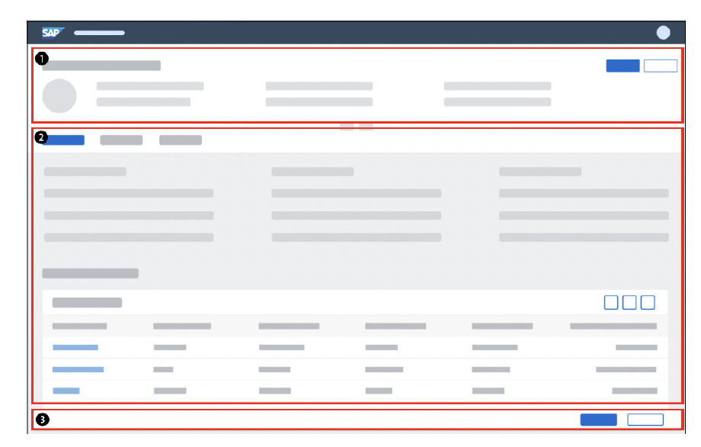
User Interface
Dynamic Page Header
Content Area
Footer Toolbar

Slide 3
User Interface Annotations
UI.lineItem The UI.lineItem annotation is used to display data from multiple data instances in a table or a list. For example, it can be used to display fields from the table in the content area of the list report.
UI.selectionField The UI annotation UI.selectionField can be used to activate a selection element in the filter bar. If a picklist is defined for the specified element, it is automatically displayed on the user interface.
UI.identificationThe annotation UI.identification is used (in conjunction with the annotation UI.headerInfo) to define which data is displayed in the content area object page.
UI.facetUse the annotation UI.facet to define a section on the ObjectPage. You can use the parentId parameter to assign sections to a parent section. The parent section must then be of type #COLLECTION.
UI.fieldGroupThe annotation UI.fieldGroup allows you to define subsections for anObject Page. You can use the annotations UI.facet and UI.fieldGroup to logically group the data in the content area of the object page in this way.
UI.headerInfo Using the annotations that belong to the UI.headerInfo annotation, you can describe an entity by assigning it a title and an optional short description. You can enter the name of the entity in both the singular and the plural. The singular is then displayed in the title, the plural as the heading of the table in the content area of the ListReport (e.g. sales order and sales orders). Optionally, you can specify a URL to call up a screen for the entity.

Slide 4
User Interface Anotations
UI.headerInfo Using the annotations that belong to the UI.headerInfo annotation, you can describe an entity by assigning it a title and an optional short description. You can enter the name of the entity in both the singular and the plural. The singular is then displayed in the title, the plural as the heading of the table in the content area of the ListReport (e.g. sales order and sales orders). Optionally, you can specify a URL to call up a screen for the entity.

